Slide 1

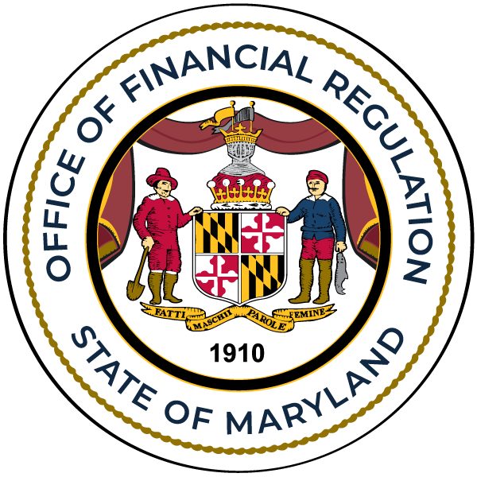

Managing Climate Change Risks and their Impact to Maryland Financial Institutions
Office of Financial Regulation
November 7, 2024

Slide 2

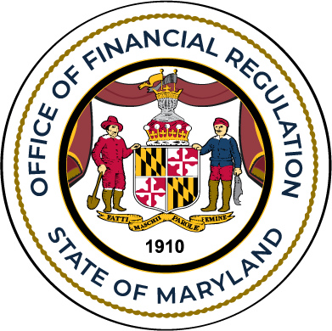


The purpose of this climate change presentation is to continue the OFR’s conversation with the Boards of Directors and managers of Maryland state-chartered credit unions and banks about the on-going risks to their institutions posed by climate change and the importance of institutions recognizing and taking appropriate steps to manage those risks.
- Tony Salazar, Commissioner of Financial Regulation

Slide 3

Z
Presentation Topics
State and National Climate-Related Risk Concepts
Update of Federal and State Action
Progress on Climate Change Risk Management Concepts with Maryland State-Chartered Banks and Credit Unions
Strategies to Manage Climate Change Risks
Takeaways on Climate Change Risks

Slide 4
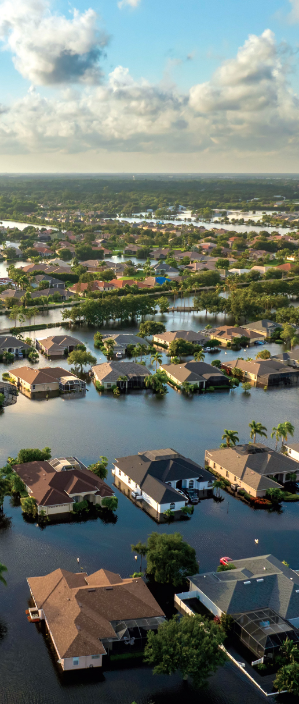
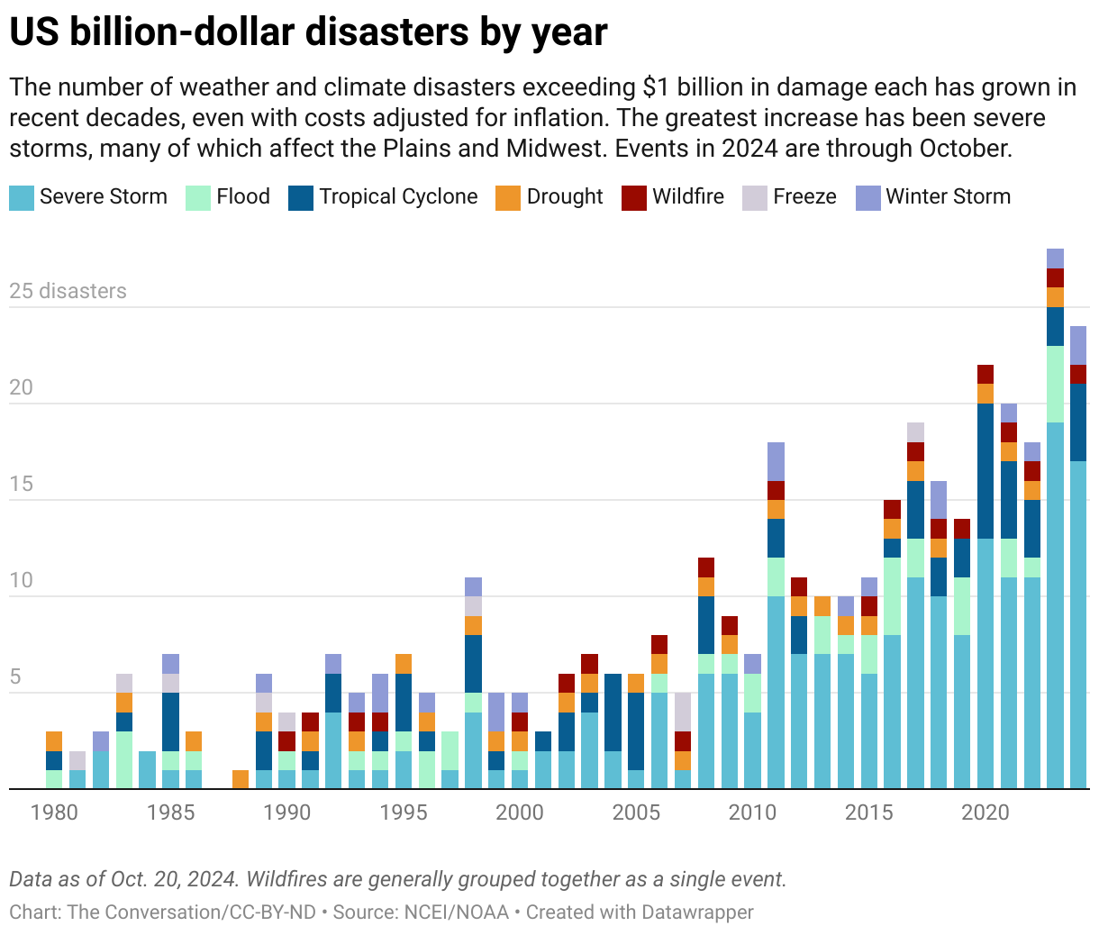

Slide 5
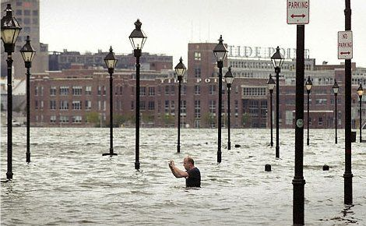
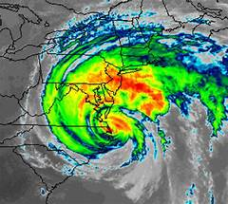
The Impact of Hurricane Ida in Maryland
Hurricane Ida in 2021 made landfall in the Gulf of Mexico yet still managed to affect Maryland spawning at least two tornadoes, causing major flooding with one death, and significant statewide damages, particularly in Anne Arundel, Frederick and Wicomico Counties.

Slide 6

State and National
Climate-Related Risk Concepts
National increase in climate-related events
Physical risk of climate change could cause potential harm to individuals and businesses arising from the increased frequency, severity, and unpredictability of acute weather events.
Climate change risk has shifted and has caused some climate-related events to adversely affect regions that have not been traditionally exposed to such events.
Maryland has experienced climate-related events such as hurricanes, tropical storms, tornados, floods, droughts and wildfires.

Slide 7
State and National
Climate-Related Risk Concepts
Transition risk encompasses uncertainties associated with shifting to a low-carbon economy driven by evolving policies and regulations, technological advancements, and changes in investor and consumer attitudes. For instance, new greenhouse gas emission laws and policies may impact the valuation of collateral and other assets.
In Maryland, Governor Moore signed a new Executive Order to achieve net-zero carbon emissions by 2045. This could be challenging for carbon-based businesses but an opportunity for other businesses that provide products and services that support a reduced carbon footprint.

Slide 8
State and National
Climate-Related Risk Concepts
As any economy decarbonizes, assets held by companies in carbon-intensive industries may be at risk of becoming partially or fully stranded and, in turn, affect borrowers’ ability to meet their financial obligations. Loan concentrations often based on occupation or geography, can worsen the impact of transition risk on loan portfolios.
Financial institutions are likely to be affected by both the physical risks and transition risks associated with climate change. Weaknesses in how banks and credit unions identify, measure, monitor, and control climate-related financial risks could adversely affect the safety and soundness of financial institutions.

Slide 9

Update on Federal and State Actions
On 10/24/2023, federal bank regulatory agencies jointly released principles that provide a high-level framework for the safe and sound management of exposures to climate-related financial risks for large financial institutions with $100 billion or more in total assets.
The framework provided general climate-related financial risk management principles with respect to a financial institution's governance; policies, procedures, and limits; strategic planning; risk management; data, risk measurement, and reporting; and scenario analysis.

Slide 10
Update on Federal and State Actions
In 2023, the NCUA issued a request to seek public input on current and future climate and natural disaster risks to federally chartered financial institutions and the National Credit Union Share Insurance Fund. The NCUA was also seeking input on the development of future guidance, regulation, reporting requirements, and/or supervisory approaches for the management of climate risks.
The FDIC listed climate change risk in its 2024 risk review with a focus on how changing climate conditions present challenges to individual institutions and the broader financial system. The report specifically listed the concern that insurance policies are becoming more expensive and unavailable which is affecting collateral protection and home affordability.

Slide 11
Update on Federal and State Actions
On March 6, 2024, the Securities and Exchange Commission adopted rules to enhance and standardize climate-related disclosures by public companies and in public offerings. The final rules reflect the Commission’s efforts to provide a rule for consistent, comparable, and reliable information about the financial effects of climate-related risks on a registrant’s operations and how it manages those risks while balancing concerns about mitigating the associated costs of the rules.
In December of 2023, the NY Department of Financial Services (DFS) issued detailed guidance for regulated banking and mortgage organizations relating to the management of material financial and operational risks from climate change.

Slide 12
Progress on Climate Change Risk Management Concepts with Maryland State-Chartered Banks and Credit Unions
2023 Climate Change Presentation Discussion
The last climate change presentation identified some key concepts that institutions should consider to help them move forward with Board and management discussions involving understanding the potential risks of climate change.
A self-assessment tool from this presentation aided in further developing a framework for research of potential climate change risks at each financial institution. A copy of this self-assessment tool will be provided with this presentation when released to the webinar participants.

Slide 13
Progress on Climate Change Risk Management Concepts with Maryland State-Chartered Banks and Credit Unions
Climate Change Examination Questionnaire
OFR developed an examination questionnaire that banks and credit unions complete as part of their regularly scheduled examination.
The use of the questionnaire started on 1/2024 and is on-going as part of the examination process.
OFR views this questionnaire as a tool with which it can gauge how each institution is responding to the climate change risk it faces.

Slide 14
Progress on Climate Change Risk Management Concepts with Maryland State-Chartered Banks and Credit Unions
Analysis of Questionnaire Results
100% of responding institutions have conducted climate change risk research since the 2023 Climate Change Presentation.
Only 38% of responding institutions had a process to report climate change risks to the Board of Directors prior to the 2023 Climate Change Presentation.
After the presentation, 75% of responding institutions reported that they have reported climate change risks to their Board of Directors.
75% of responding institutions have identified some type of exposure to climate change risk.
63% of responding institutions have set an annual schedule to report climate change risks to the Board of Directors.

Slide 15
Progress on Climate Change Risk Management Concepts with Maryland State-Chartered Banks and Credit Unions
Analysis of Questionnaire Results
75% responding institutions have considered risk mitigation strategies-mostly operational concerns only.
63% of responding institutions have started to implement risk mitigation initiatives.
75% of responding institutions discussed business continuity in their risk-mitigating strategies.
Only 38% of responding institutions discussed how climate change risks could affect loan portfolios at their institution.

Slide 16
Progress on Climate Change Risk Management Concepts with Maryland State-Chartered Banks and Credit Unions
Opportunities Based on the Questionnaire
Schedule a discussion with the Board of Directors on climate change risks.
Consider climate change risk mitigation strategies for all identified potential areas of risk of the institution not just the operational risk. For example, how will climate change affect the institution’s loan portfolios?
Focus, education, and experience will help financial institutions build the framework to support the development of mitigation initiatives.

Slide 17

Z
Strategies to Manage Climate Change Risks
Climate Change Risk Inclusion in Enterprise Risk Management
Institutions can integrate climate change risk management into their existing governance framework. When including climate risk management, institutions should take a risk-based approach, commensurate with their risk appetite and level of exposure. The framework should be flexible to accommodate new and evolving climate risks and should evolve over time with the financial institution’s understanding of climate change risks to its business strategy.
The following slides will suggest an approach on how to develop or enhance the inclusion of climate change risks in an institution’s enterprise risk management program.

Slide 18
Z
Strategies to Manage Climate Change Risks
Framework for Climate Change Risks
Risk Appetite and Strategy:
Financial institutions can incorporate climate-related risks into their overall risk framework, establishing a climate-specific risk appetite that aligns with business goals and is reassessed regularly.
Strategic Planning:
Climate risks can be addressed within the strategic business plan, integrating both short- and long-term goals that outline the financial institution’s actions to mitigate or adapt to climate risks.

Slide 19
Z
Strategies to Manage Climate Change Risks
Roles and Responsibilities to Manage the Risk Framework
Board of Directors: Responsible for overseeing climate risk strategies, defining risk appetite, and ensuring management integrates climate considerations into overall operations.
Senior Management: Charged with implementing board-approved strategies, coordinating across the organization, and establishing the "three lines of defense" model (business lines, risk management, audit) for climate risk.
Staff: Individual business units must be equipped and trained to identify, assess, and manage climate-related risk exposures.

Slide 20
Z
Strategies to Manage Climate Change Risks
Roles and Responsibilities to Manage the Risk Framework
Policy Development: Climate risks can be embedded within existing policies, standards, and procedures. Regular updates ensure alignment with current climate risk standards and evolving external factors.

Slide 21
Z
Strategies to Manage Climate Change Risks
Climate Risk Identification and Assessment
Comprehensive assessment of how climate risks (physical and transition) intersect with existing risks:
Credit Risk
Liquidity Risk
Market Risk
Operational Risk
Insurance Risk

Slide 22
Z
Strategies to Manage Climate Change Risks
Credit Risk:
The assets of the financial institution are supported by collateral whose value could materially decrease from events relating to climate change. Physical and transition risks can therefore increase credit risk when climate-related risk affects a borrower’s cash flow and/or asset values which can increase the probability of default and loss in the real estate portfolios of the financial institution.
Solutions:
Review loan portfolios for potential climate change impact.
Underwriting can take into consideration climate change risk drivers that can affect future loan repayments.
Portfolio management should review loan concentration risks with evidence of potential climate change risk.

Slide 23
Z
Strategies to Manage Climate Change Risks
Liquidity Risks:
Financial institutions should understand how a climate change event could impact liquidity based on the concentration of climate change risk that exists at the institution. The possible inflows and outflows of funds during a climate-related event could challenge the liquidity position of the institution.
Solutions:
Review the financial institution’s potential climate change risk impact determined by risk drivers such as geographical location or industry concentrations that could determine the need for liquidity.
Establish and maintain liquidity options that are activated and ready when the event occurs.
Liquidity stress testing can include climate-related events.

Slide 24
Z
Strategies to Manage Climate Change Risks
Market Risks:
Physical and transition risks may lead to sudden shifts in market expectations, supply and demand, and losses for banks and credit unions if the market value of the institution’s assets falls due to climate-related pricing shocks.
Solutions:
Financial institutions can consider the effect of climate change risk drivers on their current and future investments. This evaluation could determine whether and how these risks could lead to potential shifts in supply and demand for financial instruments that could lead to a negative impact on their values.
Climate change risk modeling at the financial institution can help understand this risk.

Slide 25
Z
Strategies to Manage Climate Change Risks
Operating Risks:
Severe weather events or chronic climate changes may cause business disruptions to financial institutions, their consumers/members, and third-party providers.
Solutions:
Operational Resiliency: Financial institutions should ensure that their governance structures and risk management processes are adequate to preserve and strengthen their operational resiliency on an ongoing basis, commensurate with their size, complexity, geographic distribution, business lines, concentrations, investment strategies, and strategic planning.
Business continuity planning should be an ongoing process that is reviewed and discussed frequently. As new challenges develop, equipment becomes outdated, and employee changes occur the plan must be current and ready to be implemented.

Slide 26
Z
Strategies to Manage Climate Change Risks
Insurance Risks:
Due to the increase in insurance losses from severe climate- and weather-related events, many insurance policies have become more expensive or not available which is causing financial institutions to deal with lapses in coverage that can affect collateral concerns along with a possible future increase in collections or foreclosures due to the inability to repay residential and commercial real estate loans.
Solutions:
Consider the impacts of premium increases or lack of coverage availability in climate scenario analysis and credit risk assessments for residential and commercial real estate loan portfolios.
Monitor force-placed policies as it could be an indicator of future issues.
Ensure loan administration departments have clear procedures to detect insurance lapses to help protect collateral and reduce losses.

Slide 27
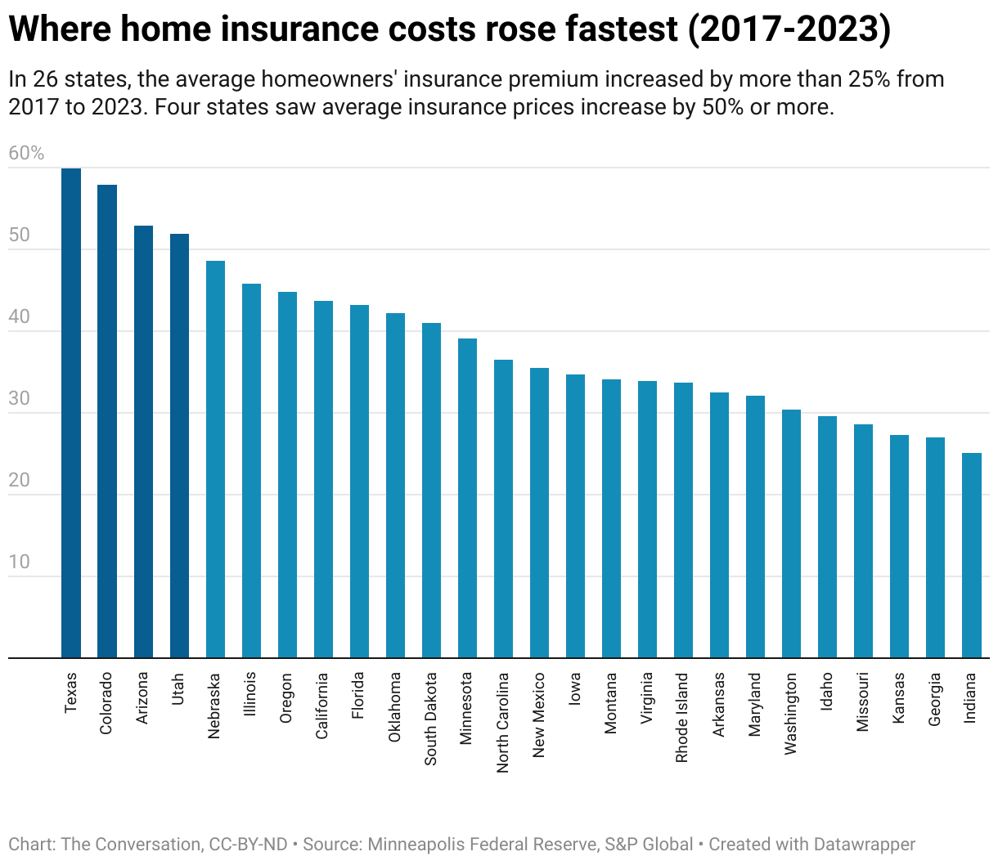
Z
Strategies to Manage Climate Change Risks

Slide 28
Z
Strategies to Manage Climate Change Risks
Monitoring:
Regular monitoring mechanisms should track evolving climate-related exposures, especially with third parties, supply chains, and vulnerable geographic regions.

Slide 29
Z
Strategies to Manage Climate Change Risks
Climate-Related Metrics
Establishing Metrics:
Institutions can develop metrics to track climate exposure accurately. Examples include monitoring the percentage of assets in flood zones or properties affected by natural disasters.
Metrics should be reliable, objective, and adaptable to different time frames (historical, current, and future projections).
Data Strategy:
Enhance data collection on property details (e.g., location, type, age) to improve exposure analysis and loss estimation. This also includes tracking insurance coverage.
Data Gaps: Identify and address any limitations in climate data. Use interim best-available metrics and update processes as new data becomes accessible.

Slide 30
Z
Strategies to Manage Climate Change Risks
Climate-Related Scenario Analysis
Purpose of Scenario Analysis:
Scenario analysis helps banks and credit unions anticipate and prepare for the potential impacts of climate risks on financial stability by assessing both gradual and severe scenarios over various time horizons.
Scenario Framework Development:
Each bank and credit union can establish a scenario analysis framework tailored to its size, complexity, and risk profile. This framework should evolve as data availability and climate-related knowledge improve.

Slide 31
Z
Strategies to Manage Climate Change Risks
Reporting and Communication Processes for
Climate Risks
Internal Reporting:
Establish reporting processes that communicate climate-related risk exposures to relevant stakeholders within the organization, from management to the Board.
Regular updates should cover scenario analysis results and any uncertainties, such as data gaps and evolving assumptions.

Slide 32
Z
Takeaways on Climate Change Risks
Exam ratings are not influenced by an institution’s climate-related actions.
OFR believes it is important to continue providing guidance and engaging in dialogue to help Maryland state-chartered banks and credit unions continue their efforts to recognize and mitigate climate risk.
OFR is encouraged by the results of the questionnaire and appreciates the efforts of Maryland state-chartered banks and credit unions to start on a path of enhancing their efforts to manage climate change risks.
Continue to be vigilant and prepared for the potential of increased climate-related events in the future.
OFR will continue to work with our federal counterparts to discuss opportunities to develop educational information to help banks and credit unions recognize and mitigate these risks.
Consider strategically enhancing the scope of climate change risk review at your institution. Climate change risk is more than just an operational risk and business continuity issue. Take a holistic approach to review your institution for all the risks discussed in this presentation.

Slide 33

Z
Resources
OFR’s Climate Change Risks and Maryland Financial Institutions presentation and self-assessment questionnaire - April 2023:
https://labor.maryland.gov/finance/banks/climate-change-risks-present.pdf
https://labor.maryland.gov/finance/banks/climate-change-self-assessment.pdf
New York State’s Guidance for New York State Regulated Banking and Mortgage Organizations Relating to Management of Material Financial and Operational Risks from Climate Change:
https://www.dfs.ny.gov/system/files/documents/2023/12/dfs_climate_change_guidance_banking_mortgage_orgs_202312.pdf
Federal Deposit Insurance Corporation - 2024 Risk Review:
https://www.fdic.gov/analysis/2024-risk-review

Slide 34

Z
Resources (cont.)
Office of the Comptroller of the Currency: Semiannual Risk Perspective Spring 2024:
https://www.occ.treas.gov/publications-and-resources/publications/semiannual-risk-perspective/files/semiannual-risk-perspective-spring-2024.html
Interagency Guidance: Principles for Climate-Related Financial Risk Management for Large Financial Institutions – October 2023
https://www.federalregister.gov/documents/2023/10/30/2023-23844/principles-for-climate-related-financial-risk-management-for-large-financial-institutions
The State of Maryland – Executive Department: Executive Order 01.01.2024.19
https://governor.maryland.gov/news/pages/executive-orders.aspx?page=2

Slide 35


Office of Financial Regulation
OFR WEBSITE
www.labor.maryland.gov/finance
  CONTACT
  Michael J. Sprouse
  Deputy Commissioner – Depository Supervision
  michael.sprouse@maryland.gov​
  410-230-6214 (Office) ​
  Teresa M. Louro
  Assistant Commissioner – Depository Supervision
  teresa.louro@maryland.gov​
  410-230-6022 (Office)
MAIN PHONE NUMBER
410-230-6100
GENERAL E-MAIL
financial.regulation@maryland.gov
MAILING ADDRESS
1100 North Eutaw Street, Suite 611
Baltimore, Maryland 21201

